Slide 1
PROJECT OUTLINE
PROJECT
LOW RANK APPROX
CLUSTERING
SVD
QR
CUR
SPECTRAL
HIERARCHIAL

Slide 2
Low Rank Approximation
Low-rank approximation is a minimization problem.
Cost function measures the fit between a given matrix (the data) and an approximating matrix (the optimization variable), subject to a constraint that the approximating matrix has reduced rank.
The problem is used for mathematical modeling and data compression.
Applications include Clustering, Signal Processing, Compression, Dimensionality Reduction.

Slide 3
Calculating Low Rank Approximations
SVD
QR factorization with column pivoting
RRQR factorization
CUR Decomposition
Nystorm Smapling Approximation
Randomized Approximations
Cross/Skeleton Approximations

Slide 4
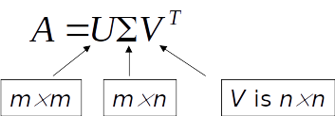
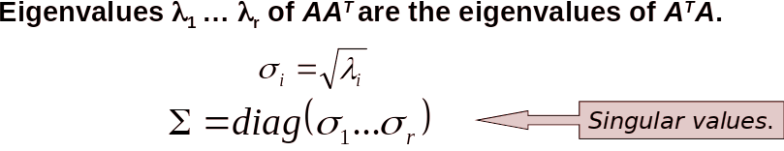
SVD (Singular Value Decomposition)
For an m n matrix A of rank r there exists a factorization (Singular Value Decomposition = SVD) as follows :
The columns of U are orthogonal eigenvectors of AA^{T}.
The columns of V are orthogonal eigenvectors of A^{T}A.

Slide 5
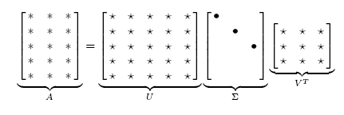
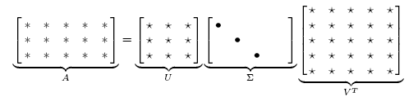
Singular Value Decomposition
Illustration of SVD dimensions and sparseness

Slide 6
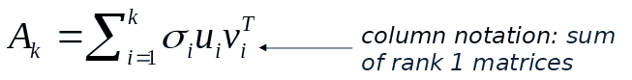
Continued..
Solution via SVD
set smallest r-k
singular values to zero
k

Slide 7
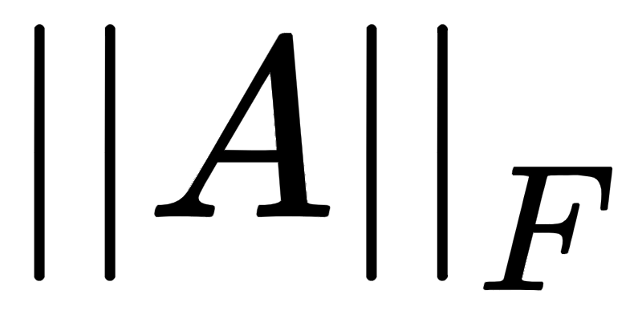
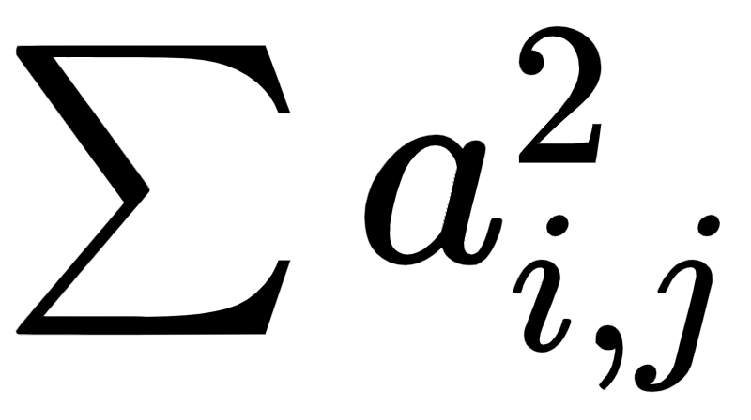
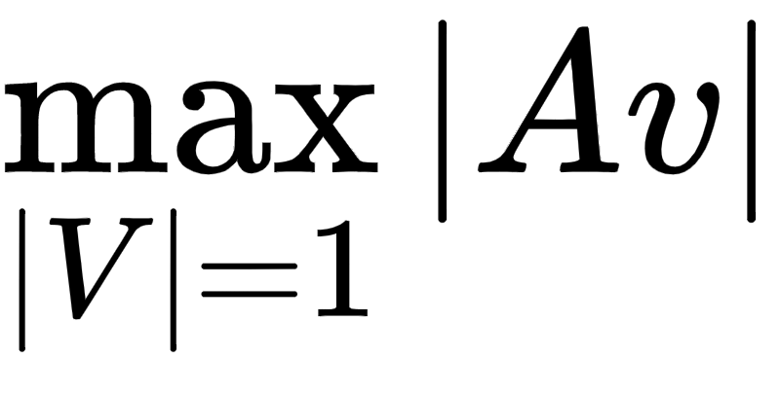
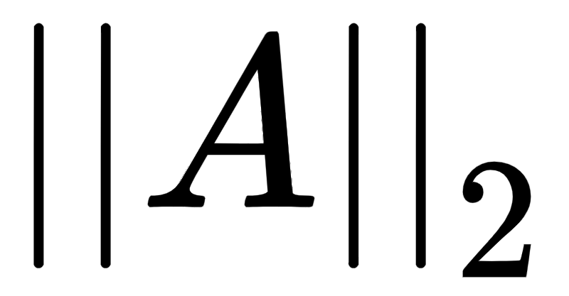
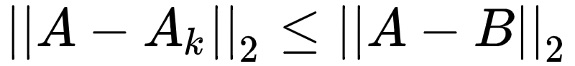
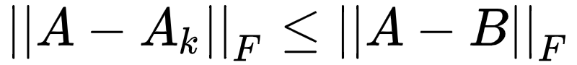
Low Rank Approximation using SVD
Frobenius Norm : =
2-Norm or spectral norm: = = largest singular value of A
Then,

Slide 8
SVD Pros and Cons
Pros:
It gives the best low rank approximation of a matrix in terms of spectral and forbenius norm.
The singular value decomposition is the creme de la creme of rank-reducing decompositions—the decomposition that all others try to beat.
Cons:
The overall computation cost is O(mn²).
If A is a square matrix, then SVD algorithm requires O(n³) . flops.
Expensive to compute if matrix dimension is very large.

Slide 9
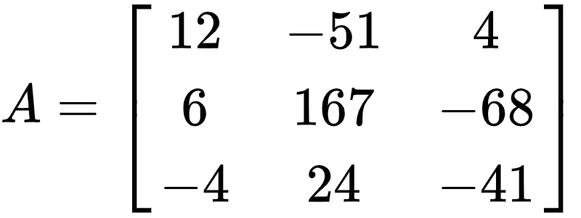
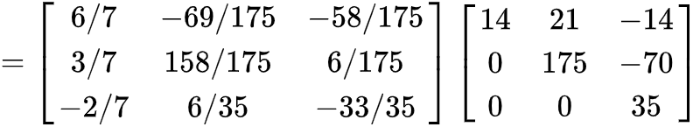
QR DECOMPOSITION
Let A be any m*n matrix whose rank is min(m,n) i.e. full rank matrix , then A can be decomposed into matrices Q and R such that A = QR
where Q is orthogonal matrix and R is upper triangular matrix with positive diagonal entries.
For example,

Slide 10
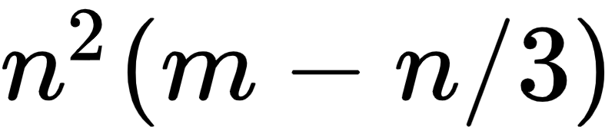
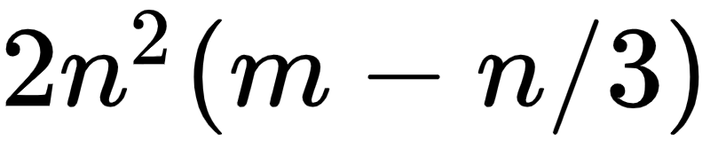
Computing Q and R
There are several ways of computing QR factorization:-
GS or modified GS
Givens Rotations
Householder Reflections
Floating point operations required in Householder Reflections ≈
Whereas, Floating point operations required in Givens Rotations ≈

Slide 11

Applications Of QR decomposition
In Solving system of equations AX=b.
Since A can be decomposed into product of Q and R , therefore
QRX=b RX = b
Thus we bypassed the process of finding the inverse of a matrix and since R is upper triangular matrix , hence easy to compute X.
It is also useful in solving least squares problem where number of equations are more than unknowns (overdetermined systems).

Slide 12
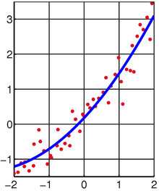

Slide 13
CUR DECOMPOSITION
Any matrix A can be decomposed into matrices C , U , R such that A can be written as
A = CUR
where,
C is composed of column vectors that are subsets of A
R is composed of row vectors that are subsets of A
U is carefully chosen matrix such that A≈CUR

Slide 14
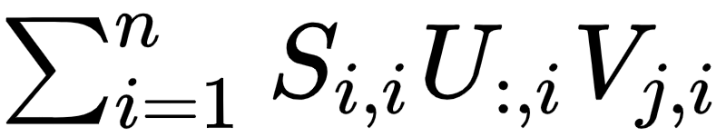
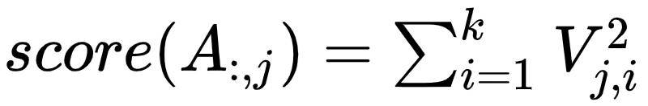
COMPUTING CUR
There are many techniques for computing matrices C , U , R
We studied LeverageScoreCUR or simply LSCUR
Based on calculating Leverage score for each column vector.
Leverage score is calculated by first calculating SVD decomposition of jth column of A=
Then

Slide 15
APPLICATIONS
Problem: m customers and n products; Aij is the (unknown) rating/utility of
product j for customer i
Goal: recreate A from a few samples to recommend high utility products
Solution: We apply CUR Algorithm
Few customers,
all preferences
≈
customers
Products All customers,
Few preferences
A
C
U
R

Slide 16
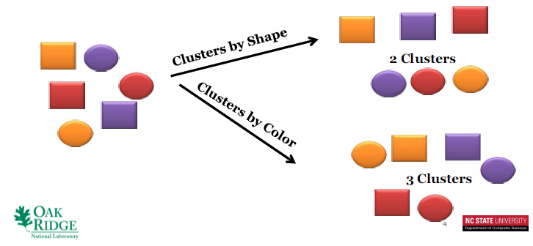
What is Clustering?
Dividing a set of input data into possibly overlapping subsets
Elements in each subset are considered related by some similarity measure.

Slide 17
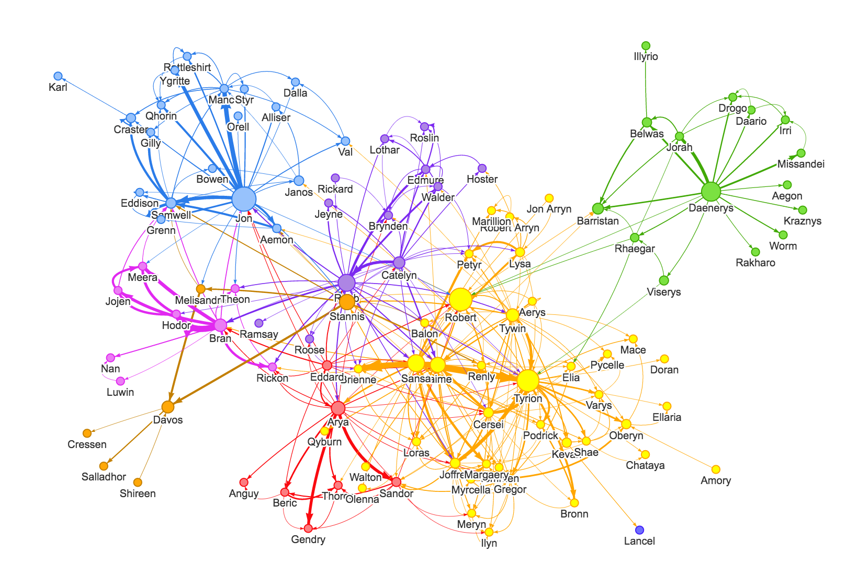
What is Graph Clustering?
Partition a graph into natural groups using a similarity measure.
Nodes in the same cluster are more close to each other than to those in other clusters.
For our study, we only consider undirected graphs.

Slide 18
Graph Clustering Techniques
Kernel K-means
Spectral Clustering
Hierarchical Clustering
Shared Nearest Neighbour
Maximal Clique Enumeration
Highly connected Components
We brief about three clustering techniques : Spectral Clustering, Hierarchical and K-means Clustering.

Slide 19
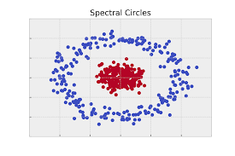
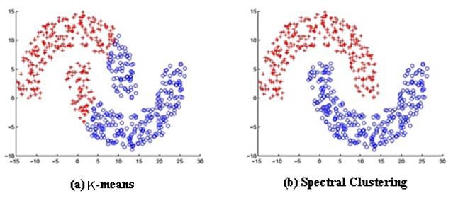
Spectral Clustering
A technique with roots in graph theory.
Used to identify communities of nodes in a graph based on the edges connecting them.
Flexible as it allows clustering of non-graph data.
Uses information from the eigenvalues (spectrum) of special matrices built from the graph or the data set.

Slide 20
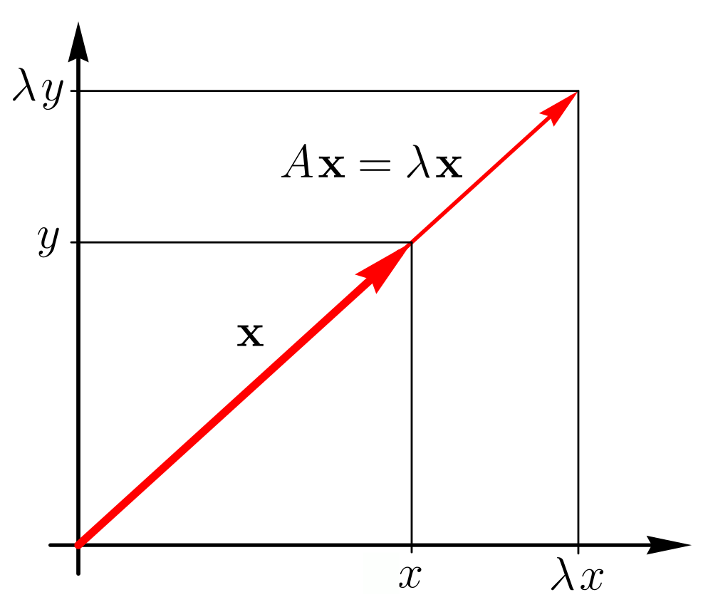
Eigenvalues and Eigenvectors
Given a square matrix A,
If there exists a non-zero vector x and a scalar λ such that
Ax = λx
then x is said to be an eigenvector of A with corresponding eigenvalue λ.
Matrix A can be considered as a function which maps vectors to new vectors.
Most vectors will end up somewhere completely different when A is applied to them, but eigenvectors only change in magnitude.
x is an eigenvector

Slide 21
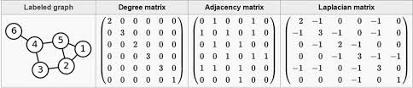
Adjacency, Degree and Laplacian Matrices
Adjacency Matrix of graph (A)
Row and column indices represent he nodes.
Entries represent the absence or presence of an edge between the nodes.
If the edges were weighted, the weights of edges would go in this matrix instead of just 1s and 0s.
Degree Matrix of a Graph (D)
A diagonal matrix where the value at entry (i, i) is the degree of node i.
Laplacian Matrix (L)
L = D - A

Slide 22
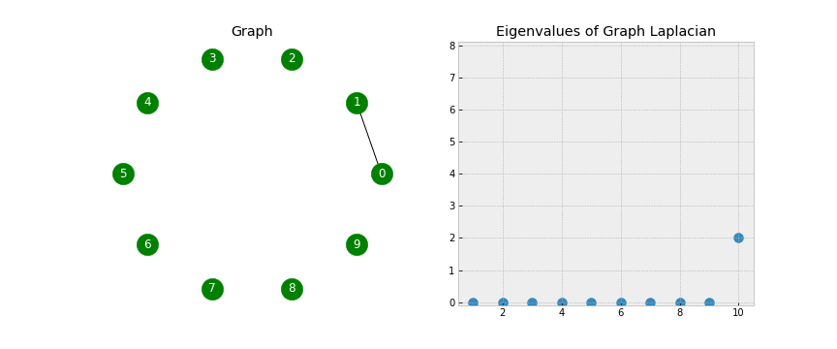
Graph Laplacians
Graph Laplacians have some beautiful properties which we shall exploit for spectral clusterings.
To get a sense for this, let’s examine the eigenvalues associated with the Laplacian as edges are added to our graph:
Notes:
Look closely as that final edge is added, connecting the two components into one. When this happens, all of the eigenvalues but one have been lifted:

Slide 23
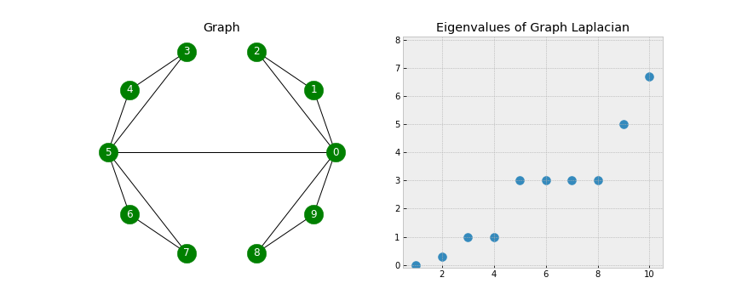
Spectral Gap
Look closely as that final edge is added, connecting the two components into one. When this happens, all of the eigenvalues but one have been lifted..
Number of zero eigenvalues represent the number of connected components.
The first nonzero eigenvalue is called the spectral gap. The spectral gap gives us some notion of the density of the graph. If this graph was densely connected (all pairs of the 10 nodes had an edge), then the spectral gap would be 10.

Slide 24
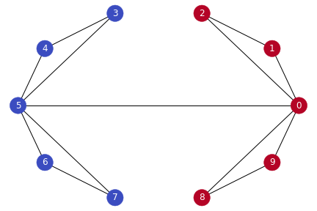
Fiedler Value
The second smallest eigenvalue is called the Fiedler value, and the corresponding vector is the Fiedler vector.
The Fiedler value approximates the minimum graph cut needed to separate the graph into two connected components.
If our graph was already two connected components, then the Fiedler value would be 0.
Each value in the Fiedler vector gives us information about which side of the cut that node belongs.
Choosing 0 as a threshhold for partitioning on the baisis of fiedler vector.

Slide 25
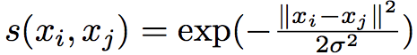
Steps for Spectral Clustering
!. Compute the similarity graph
Create an undirected graph G = (V, E) with vertex set V = {v1, v2, …, vn} = 1, 2, …, n observations in the data.
Represent by an adjacency matrix which has the similarity between each vertex as its elements .
To do this, we can either compute:
The ε-neighborhood Graph: Here we connect all points whose pairwise distances are smaller than ε.
KNN Graph: Here we use K Nearest Neighbors to connect vertex v_{i} with vertex v_{j} if v_{j} is among the k-nearest neighbors of v_{i}. After connecting the appropriate vertices we weight the edges by the similarity of the adjacent points.
Fully connected graph: To construct this graph, we simply connect all points with each other, and we weight all edges by similarity sij. This graph should model the local neighborhood relationships, thus similarity functions such as Gaussian similarity function are used.
Notes:
s the distances between all connected points are roughly of the same scale (at most ε), weighting the edges would not incorporate more information about the data to the graph. Hence, the ε-neighborhood graph is usually considered as an unweighted graph.

Slide 26
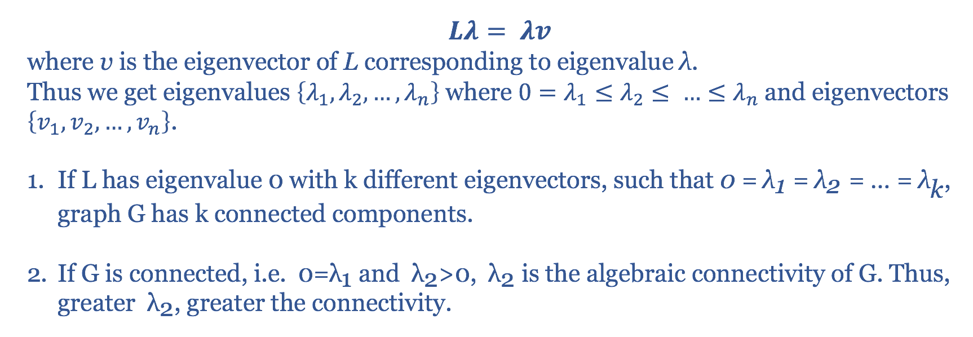
Continued..
2. Project the data onto a low dimensional subspace
Compute the Graph Laplacian.
Find eigenvalues and eigenvectors for it, in order to embed the data points into a low-dimensional space.
So now, we can go ahead and find eigenvalues. We know that:

Slide 27
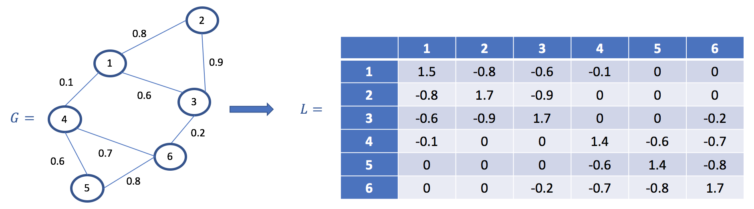
Continued..
Let’s consider an example with numbers...

Slide 28
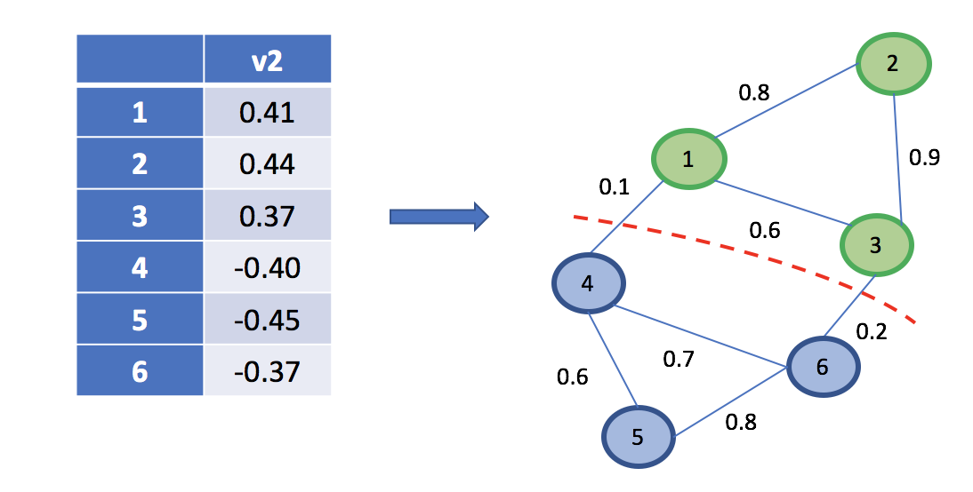
Continued..
3. Create Clusters
Use the eigenvector corresponding to the 2nd eigenvalue to assign values to each node.
To get bipartite clustering (2 distinct clusters), assign element of v2 to the nodes.
Split the nodes with 0 as a threshold.
We get nodes 1, 2 & 3 in one cluster, and 4, 5 & 6 in the 2nd cluster.
It is important to note that the 2nd eigenvalue indicates how tightly connected the nodes are in the graph. For good, clean partitioning, lower the 2nd eigenvalue, better the clusters.

Slide 29
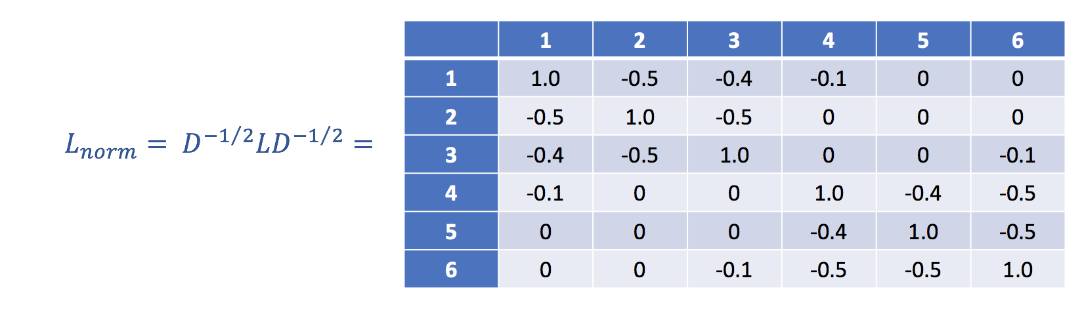
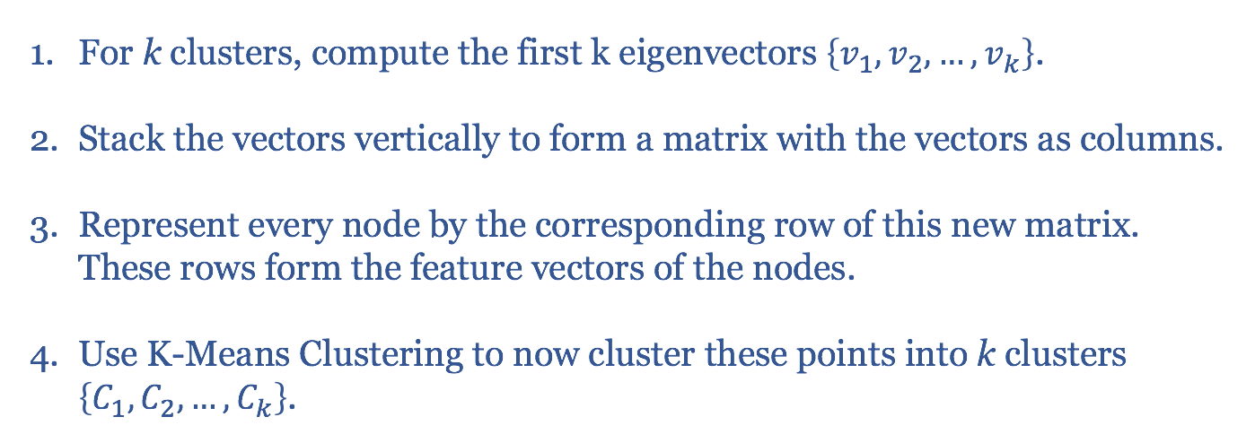
Continued..
For k clusters, we have to modify our Laplacian to normalize it. We get,

Slide 30
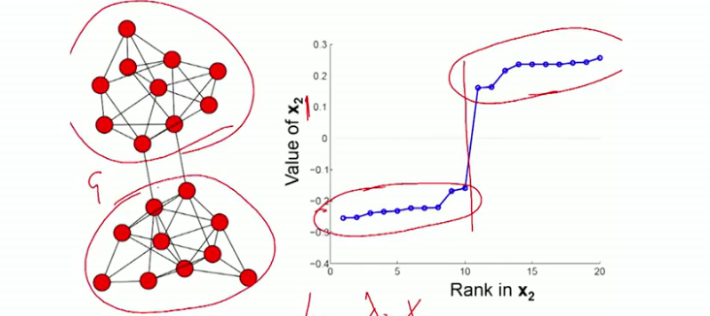
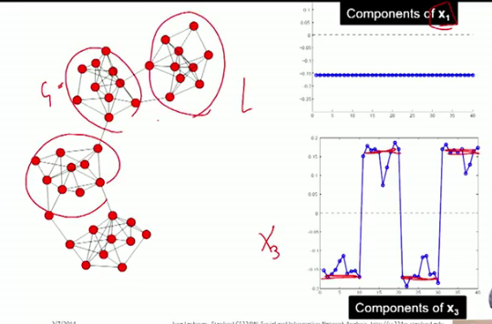
Examples

Slide 31
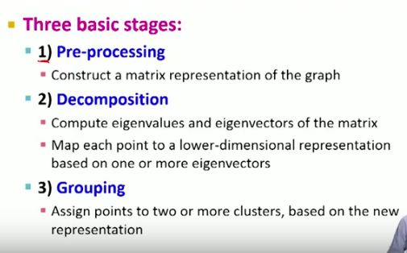
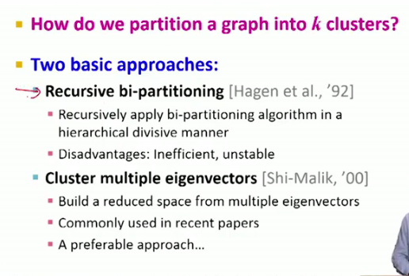
Summary

Slide 32
Advantages and Disadvantages
Advantages:
Spectral Clustering is more general compared to K-means.
Easy to implement and gives good clustering results.
Reasonably fast for sparse data sets of several thousand elements.
Disadvantages:
Use of K-Means clustering in the final step implies that the clusters are not always the same. They may vary depending on the choice of initial centroids.
Computationally expensive for large datasets. For large, dense datasets, this may increase time complexity quite a bit.

Slide 33
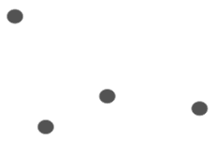
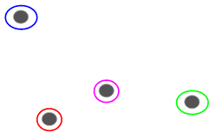
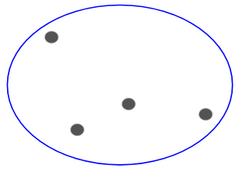
Hierarchical Clustering
Let’s say we have the below points and
we want to cluster them into groups:
We can assign each of these points
to a separate cluster:
Based on similarity, we can combine
the most similar clusters together
Repeat this process until only a single cluster is left:

Slide 34

Hierarchical Clustering
Essentially building a hierarchy of clusters.
That’s why this algorithm is called hierarchical clustering.

Slide 35
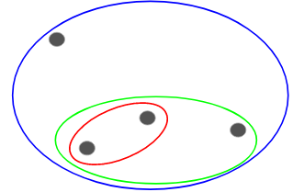
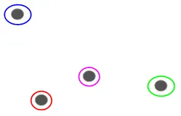
Types of Hierarchical Clustering
Agglomerative Hierarchical Clustering
Divisive Hierarchical Clustering

Slide 36
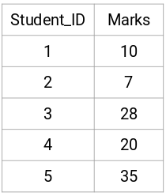
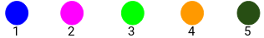
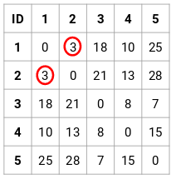
Steps to perform Agglomerative Hierarchical Clustering
Step 1: First, we assign all the points to an individual cluster:
Step 2: Next, we will look at the smallest distance in the proximity matrix and merge the points with the smallest distance. We then update the proximity matrix:

Slide 37
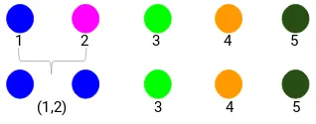
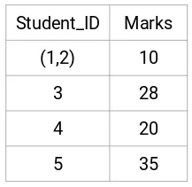
Steps to perform Agglomerative Hierarchical Clustering
Here, the smallest distance is 3 and hence we will merge point 1 and 2:
Here, we have taken the maximum of the two marks (7, 10) to replace the marks for this cluster. Instead of the maximum, we can also take the minimum value or the average values as well.

Slide 38
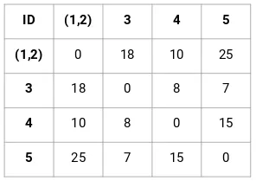
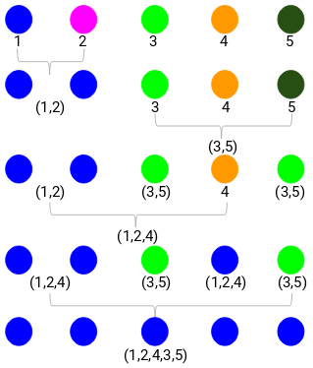
Steps to perform Agglomerative Hierarchical Clustering
Now, we will again calculate
the proximity matrix for these clusters:
Step 3: We will repeat step 2 until only a single cluster is left.
We started with 5 clusters and finally have a single cluster. This is how the algorithm for clustering works.

Slide 39
Choosing the number of Clusters
To get the number of clusters for hierarchical clustering, we make use of an awesome concept called a Dendrogram.
A dendrogram is a tree-like diagram that records the sequences of merges or splits.

Slide 40
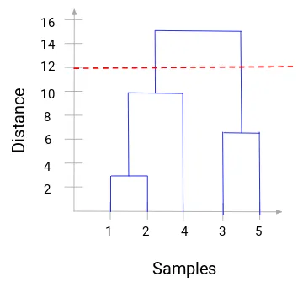
Choosing the number of Clusters
We can clearly visualize the steps of hierarchical clustering.
More the distance of the vertical lines in the dendrogram, more the distance between those clusters.
Now, we can set a threshold distance and draw a horizontal line.
The number of clusters will be the number of vertical lines which are being intersected by the line drawn using the threshold.

Slide 41
REFERENCES
A.Y. Ng, M.I. Jordan, Y. Weiss
On spectral clustering: Analysis and an algorithm
T.G. Dietterich, S. Becker, Z. Ghahramani (Eds.), Advances in Neural Information Processing Systems,
vol. 14, MIT Press, Cambridge, USA (2001)
Mahoney, Michael W. and Petros Drineas.
CUR matrix decompositions for improved data analysis.
Proceedings of the National Academy of Sciences of the United States of America 106 3 (2009): 697-702 .
M.E.J. Newman
Finding community structure in networks using the eigenvectors of matrices
Phys. Rev. E, 74 (3) (2006), p. 036104
N. Kishore Kumar and J. Schneider

Slide 42
FURTHER STUDY
Read different other algorithms on low rank approximations and clustering techniques
explore the Girvan Newman Algorithm and attempt to combine it with low rank approximations for
community detection in social networks.
We will analyse our algorithms on a publicly available social network dataset using MATLAB or python.
Results and graphical solutions will be presented.
Conclusions will also be drawn on low rank approximations and graph clusterings.

Slide 43

STUDY PROJECT
(MATH F266)
PREPARED BY:
DHRUV PATEL(2017B4A70583P)
ABDUL KADIR KHIMANI(2017B4A70696P)
INSTRUCTOR
Dr. RAJIV KUMAR
DEPARTMENT OF MATHEMATICS

Slide 44
Graph Clustering, Low rank Approximations and Social Network Analysis

Slide 45

Girvan-Newman Algorithm
Proposed by Girvan and Newman for graph clustering.
Based on Divisive Clustering.
Edges are successively removed from a network, in contrast to the agglomerative clustering method.
Edges are removed on the basis of edge-betweenness scores.

Slide 46



Edge Betweenness
The betweenness of an edge (v₁, v₂) is the number of pairs of nodes u and w such that the edge (v₁, v₂) lies on the shortest path between u and w.
Informally, it is the number of shortest paths that pass along the edge.
The edge betweenness of e(1, 2) is 4(= 6/2 + 1), as all the shortest paths from 2 to {4, 5, 6, 7, 8, 9} have to either pass e(1, 2) or e(2, 3), and e(1,2) is the shortest path between 1 and 2
The edge with higher betweenness tends to be the bridge between two communities.

Slide 47




Breadth First Search
Breadth-first search (BFS) is a method for traversing all the nodes of a tree or graph, one level at a time.
BFS finds the shortest path between the starting point and any other reachable node.
Traverse through one level of children, then through grandchildren and so on..

Slide 48

Understanding the Algorithm
Perform a breadth-first search(BFS) on the graph, starting at the node X.
We will apply GN algorithm on the graph below.

Slide 49

...
Parent
DAG Edges
(Directed Acyclic Graph)
Child
BFS with start node as A
Notes:
The edges that are between levels are called Directed Acyclic Graph edges (DAG). Each DAG edge will be part of at least one shortest path from root X. If there is a DAG edge (Y,Z), where Y is at the level above Z (i.e., closer to the root), then we shall call Y a parent of Z and Z a child of Y.

Slide 50

...
2. Label each vertex by the number of shortest paths from root to node.
Start by labeling the root as 1.
Then, from the top label each node by the sum of the labels of its parents.

Slide 51
...
3. Calculate for each edge e the sum over all nodes Y of the fraction of shortest paths from the root X to Y that go through e.
The rules for the calculation are as follows:
1. Leaf 1
2. Non-leaf (1 + the sum of the scores of the DAG edges from that node to the level just below).
3. A DAG edge e entering node Z from the level above is given a share of the credit of proportional to the fraction of shortest paths from the root to Z that go through e.
Formally, let the parents of Z be Y₁, Y₂, . . . , Y_{k}. Let p_{i} be the number of shortest paths from the root to Y_{i} -- This number was computed in Step 2.
Credit for the edge (Y_{i} , Z) is the credit of Z times p_{i} divided by ⅀ p_{i} .
Notes:
(a leaf is a node with no DAG edges to other nodes at levels below)

Slide 52

...

Slide 53


...
Repeat the previous steps with all nodes as root

Slide 54


...

Slide 55

...
4. Take each node as the root and find the betweenness scores for each edge and sum them.

Slide 56

...
5. Divide by 2 to get the true betweenness, since every shortest path
will be traversed twice, once for each of its endpoint.

Slide 57

...
6. Remove the edges with highest betweenness and repeat from step 2.

Slide 58

Modularity and Number of Clusters
Modularity - A measure to decide the number of clusters.
For a division with g groups, define a g × g matrix e whose each component e_{ij} is a fraction of edges in the original network that connect vertices in group i to those in group j. Then the modularity is defined to be
where || x || indicates the sum of all elements of x.
Measures the internal density and external sparsity of a given clustering.
Quantitatively, Q is the fraction of all edges that lie within clusters minus the expected value of the same quantity in a graph where the vertices have the same degrees and edges are placed randomly irrespective of the communities.

Slide 59

...
Another way of representing Q can be :
Q = (number of edges within groups) - (expected number of edges within groups)
Modularity lies in the range [−1,1].
0.3<Q<0.7 means significant community structure.
m = number of edges
A_{ij} = 1 if (i,j) is edge, else 0
k _{i} = Degree of node i
C_{i} = group id of node i
δ(c_{i}, c_{j}) = 1 if i and j in same community, else 0

Slide 60

Example

Slide 61

...

Slide 62


Is Modularity the best metric?

Slide 63


On Common Graphs

Slide 64


...

Slide 65
FInal Girvan-Newman Algorithm
BestQ = 0
Read the input file (the crawled data) and build the corresponding social graph G.
Compute the number of components of the graph G (init_ncomp).
Calculate the weighted version of edge-betweenness for all edges of the graph G.
Find the edge with the highest betweenness and remove it from G.
Compute the number of components in G after edge removal (ncomp).
If ncomp <= init_ncomp go to step 3.
Compute the modularity of the current version of graph G and store it in Q.
If Q > BestQ then save the current decomposition of G as the best division in BestComps.
If there is not any edge left in G, return BestComps otherwise go to step 2.

Slide 66
COMMUNITY DETECTION USING NETWORK TOPOLOGY

Slide 67
DETECTING COMMUNITIES USING NETWORK TOPOLOGY
TERMINOLOGIES
•A sub-network is defined as a strong sense community if its internal connections are larger than its external connections.
•A sub-network is defined as a weak sense community, if its internal connections are equal or smaller than its external connections, but its internal connections are larger than the connections between this sub-network and any other communities.
•Community membership property :- Member of a community should have more neighbors within its community than in any other community, unless it is an overlapping member.
•overlapping node, should be tightly connected with both communities, and there should be few connections between the two corresponding communities if remove such nodes

Slide 68


Slide 69


Slide 70

ILLUSTRATION

Slide 71
STEP:1 INITIALIZE ADJACENCY LIST OF NODES
c{1}=[1, 2, 3, 4, 5, 6, 7, 8, 9, 11, 12, 13, 14, 18, 20, 22, 32]; c{2}=[1, 2, 3, 4, 8, 14, 18, 20, 22, 31];
c{3}=[1, 2, 3, 4, 8, 9, 10, 14, 28, 29, 33]; c{4}=[ 1, 2, 3, 4, 8, 13, 14];
c{5}=[ 1, 5, 7, 11]; c{6}=[ 1, 6, 7, 11, 17];
c{7}=[ 1, 5, 6, 7, 17]; c{8}=[ 1, 2, 3, 4, 8];
c{9}=[ 1, 3, 9, 31, 33, 34]; c{10}=[ 3, 10, 34];
c{11}=[ 1, 5, 6, 11]; c{12}=[ 1, 12];
c{13}=[ 1, 4, 13]; c{14}=[ 1, 2, 3, 4, 14, 34];
c{15}=[ 15, 33, 34]; c{16}=[ 16, 33, 34];
c{17}=[ 6, 7, 17]; c{18}=[ 1, 2, 18];
c{19}=[ 19, 33, 34]; c{20}=[ 1, 2, 20, 34];
c{21}=[ 21, 33, 34]; c{22}=[ 1, 2, 22];
c{23}=[ 23, 33, 34]; c{24}=[ 24, 26, 28, 30, 33, 34];
c{25}=[ 25, 26, 28, 32]; c{26}=[ 24, 25, 26, 32];
c{27}=[ 27, 30, 34]; c{28}=[ 3, 24, 25, 28, 34];
c{29}=[ 3, 29, 32, 34]; c{30}=[ 24, 27, 30, 33, 34]
c{31}=[ 2, 9, 31, 33, 34]; c{32}=[ 1, 25, 26, 29, 32, 33, 34];
c {33}=[ 3, 9, 15, 16, 19, 21, 23, 24, 30, 31, 32, 33, 34];
c {34}=[ 9, 10, 14, 15, 16, 19, 20, 21, 23, 24, 27, 28, 29, 30, 31, 32, 33, 34];

Slide 72
Step2: Detect Strong sense communities
Compare the internal connections and external connections of every adjacency list c{i}, (i=1,…,34), If the former is larger than the latter, then define c{i} as a strong sense community. In this example, c{1}, c{2}, c{33} and c{34} are strong sense communities. We define these as candidate communities P{j} (j=1,…,4), and empty c{1}, c{2}, c{33} and c{34}.

Slide 73
Step3: Detect Weak sense communities.
For each non-null c{i}, if its internal connections are larger than the maximum connections between it and every P{j}, then we take c{i} as a new candidate community and empty it. In this example, we didn’t find any new candidate weak sense communities.

Slide 74
Step4: Assign unallocated nodes.
After the first three steps, if some nodes are still unallocated, then for each one we assign it to the candidate community, which has the most connections with it. In this example, nodes 17, 25 and 26 are initially unallocated. We assign node 17 to P{1}, and node 25 and 26 to P{4} based on their connections:
P{1}=[ 1, 2, 3, 4, 5, 6, 7, 8, 9, 11, 12, 13, 14, 17, 18, 20, 22,32];
P{2}=[ 1, 2, 3, 4, 8, 14, 18, 20, 22, 31];
P{3}=[ 3, 9, 15, 16, 19, 21, 23, 24, 30, 31, 32, 33, 34];
P{4}=[ 9, 10, 14, 15, 16, 19, 20, 21, 23, 24, 25, 26, 27, 28, 29, 30, 31, 32, 33, 34];

Slide 75
Step5: Delete redundant and significant overlapping communities
For each candidate community, check whether it is equal, or a proper subset of other candidate communities. If it is, delete it. Otherwise, if two communities are significantly overlapping (if the overlapping nodes of two communities is larger than half the number of nodes of the smaller community), delete the intersection from the smaller one.
In this example, no redundant communities exist, but P{1} is significantly overlapping with P{2}, as are P{3} and P{4}.
After we delete the intersections, there remain three candidate communities:
P{1}=[ 1, 2, 4, 5, 6, 7, 8, 11, 12, 13, 14, 17, 18, 20, 22];
P{2}=[31];
P{4}=[ 3, 9, 10, 14, 15, 16, 19, 20, 21, 23, 24, 25, 26, 27, 28, 29, 30, 31, 32, 33, 34];

Slide 76
Step6: Adjust misallocated nodes.
Except for overlapping nodes, for each member of candidate community P{j}, compute the connections between it and every candidate community, and assign it to the community which has the most connections with it. In this example, node 31 is misallocated and is reassigned to P{4}.
Now there are only two candidate communities left:
P{1}=[ 1, 2, 4, 5, 6, 7, 8, 11, 12, 13, 14, 17, 18, 20, 22];
P{4}=[ 3, 9, 10, 14, 15, 16, 19, 20, 21, 23, 24, 25, 26, 27, 28, 29, 30, 31, 32, 33, 34];

Slide 77
Step7: Adjust overlapping nodes.
For each overlapping node between any two communities, if it has equal neighbors with the two communities and has equal distance with their corresponding hub nodes, we define it as an overlapping node. Otherwise, we assign it to the community with which it has the most neighbors. In this case, nodes 14 and 20 are overlapping nodes of two
communities, and they are all assigned to P{1}. Now the result is:
P{1}=[ 1, 2, 4, 5, 6, 7, 8, 11, 12, 13, 14, 17, 18, 20, 22];
P{4}=[ 3, 9, 10, 15, 16, 19, 21, 23, 24, 25, 26, 27, 28, 29, 30, 31, 32, 33, 34];

Slide 78
Step8: Check whether candidate communities satisfy our definition.
For each candidate community, if it doesn’t satisfy the weak sense community definition, merge it with the one with which it has the most connections. In this example, the remaining two candidate communities satisfy the community definition.
Because some members changed between the two communities, we need repeat step7 and step8 until there is no change in any community.
There are no unallocated nodes at this point, so we output the two final communities:
P{1}=[ 1, 2, 3, 4, 5, 6, 7, 8, 11, 12, 13, 14, 17, 18, 20, 22];
P{4}=[ 9, 10, 15, 16, 19, 21, 23, 24, 25, 26, 27, 28, 29, 30, 31, 32, 33, 34];
As shown in Fig.S1, P{1} is the yellow community, and P{4} is the cyan community

Slide 79


Slide 80

MODULARITY MEASURE
For cluster I
l₁=33 , L=78 , d₁=76
Q₁=0.186
For cluster II
l₂=35 , L=78 , d₂=80
Q₂=0.1857
Hence modularity of this network is = 0.3717

Slide 81

ANALYSIS OF EMPIRICAL NETWORKS

Slide 82
REFERENCES
Helio Almeida1, Dorgival Guedes1, Wagner Meira Jr.1, and Mohammed J. Zaki.
Is there a best quality metric for graph clusters?
Mahoney, Michael W. and Petros Drineas.
S. Fortunato
Community detection in graphs.
arXiv:0906.0612, June 2009.
M.E.J. Newman
Detecting community structure in networks
Eur. Phys. J. B 38, 321–330 (2004)
M. Girvan and M. E. J. Newman
Community structure in social and biological networks.
Proceedings of the National Academy of Sciences of the United States of America, p.p. 7821--7826, vol. 99, June 2002.

Slide 83
Liu, Wei, Matteo Pellegrini, and Xiaofan Wang.
Detecting communities based on network topology.
Scientific reports 4 (2014): 5739.
S. Schaeffer
Graph clustering. Computer Science Review
1(1):27–64, 2007

Slide 84
THANKYOU

